Slide 1



Slide 2



Slide 3
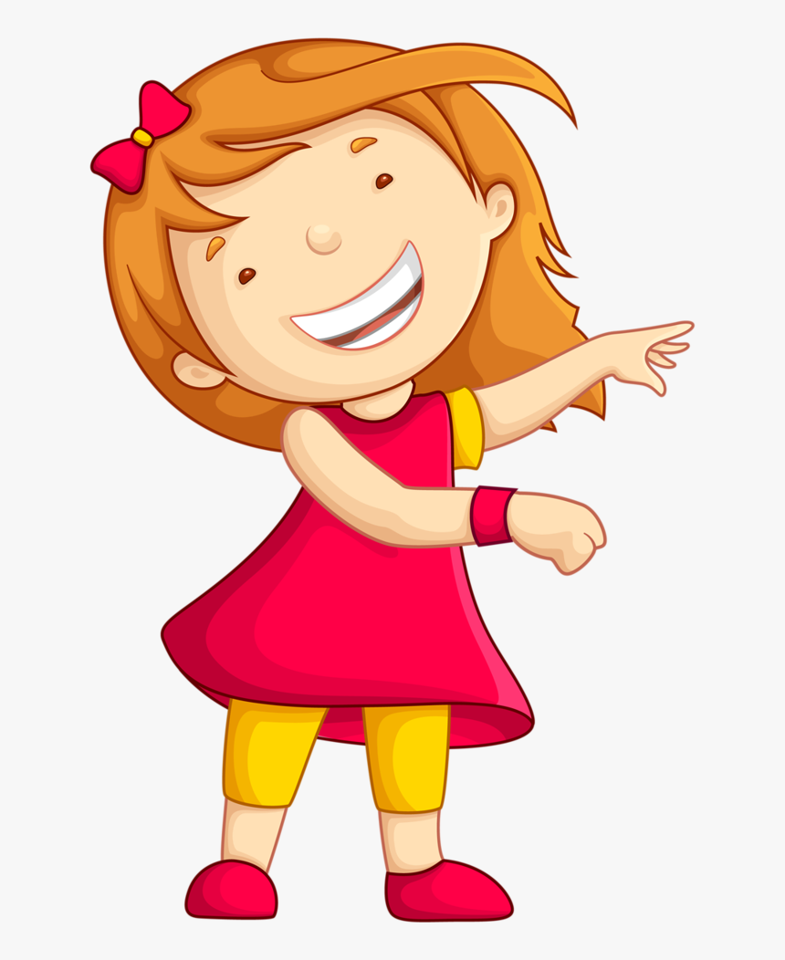
Dear Children, We will be looking ahead the given below concepts Numbers 1- 20. *Read and write Numbers up to 20
I am ready Ma’am!!

Slide 4

Lets begin the class with a quick counting activity.

Slide 5

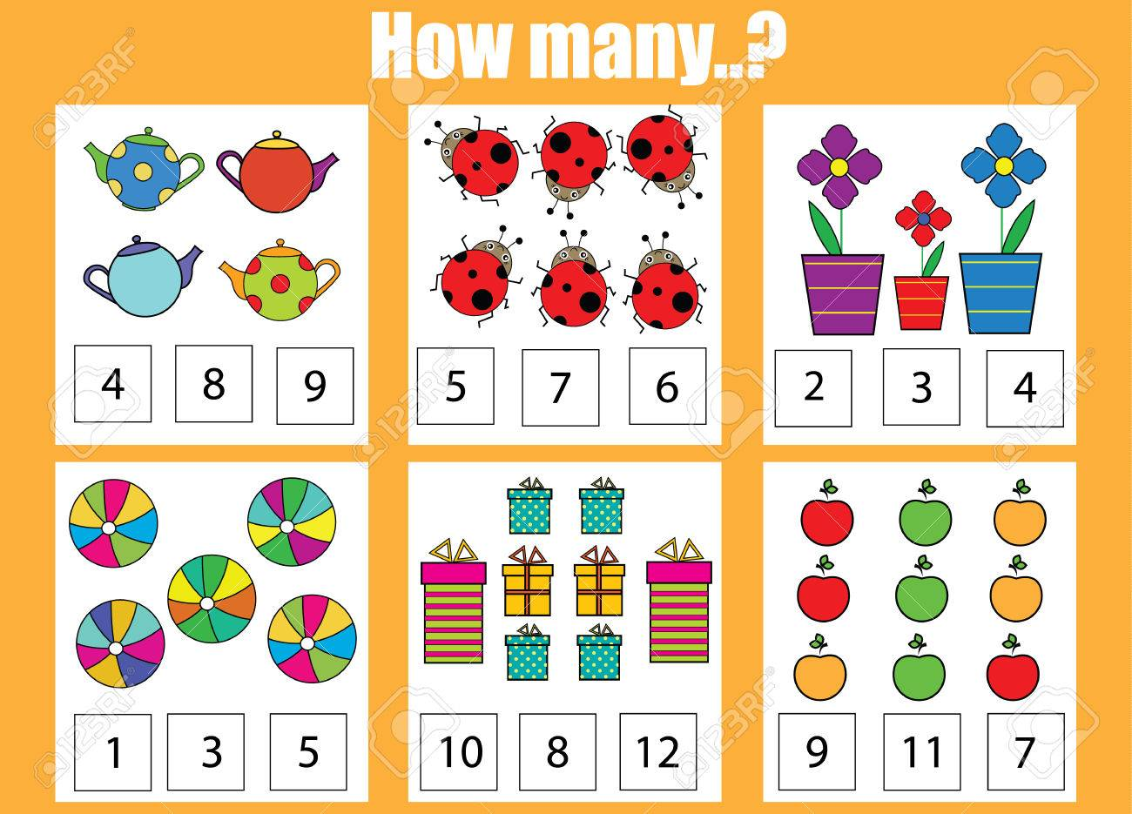
How many..?

Slide 6

That was brilliant!! Children, Now we will look at the number grid and do the counting from 1-20. Here we go…

Slide 7
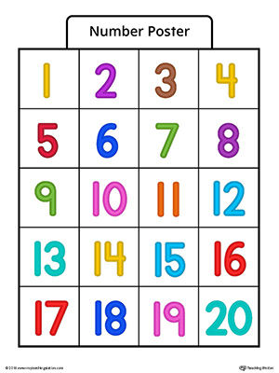
Come on little ones start counting from Number 1…

Slide 8

Let’s sing and learn numbers 1-20.
Click this link to sing and learn 1-20:
https://www.youtube.com/watch?v=D0Ajq682yrA

Slide 9
That was amazing!! You have learnt number names 1-20 in UKG so for a quick recap let’s us unscramble the number names in the worksheet. Shall we start?
https://www.liveworksheets.com/qc19662mp

Slide 10

Hurray!! You have unscrambled it !! Now its Quiz time. Children, Are you ready to answer the quiz. Yes! Here we go….

Slide 11
Quiz Time( 0-10)
1 How many wings do you have?
2. How many seeds are there in a mango?
3. How many eyes do you have?
4. How many wheels are there in a tricycle?
5. How many legs does a cow have?
6. How many fingers do you have in one hand?
7. How many legs does a grasshopper have?
8. How many colours are there in a rainbow?
9. How many legs does a spider have?
10. Who looks like 6 turned upside down?
11. How many fingers are there in both your hands?

Slide 12

Hope you enjoyed the quiz. For those who got all the answers correct a High Five for you!! For whose who couldn't , better luck next time! Now let’s read the number names from 1-20. Are you ready?

Slide 13
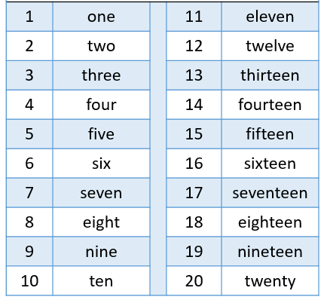

Slide 14
Teen words
13- Thirteen
14- fourteen
15- fifteen
16- sixteen
17- seventeen
18- eighteen
19- nineteen

Slide 15

Wow!! We have completed counting 1-20 and reading the number names.

